Slide 1
Index-Based Encoding

Slide 2
Index-Based Encoding
Index-based encoding, also known as one-hot encoding, is a method for representing text data in a numerical format.
• This method is simple and efficient for deep learning models.
• Each unique word or character in the vocabulary is assigned a unique index.
• Text sequences are represented as a vector of indices, where each index corresponds to a word or character in the sequence.

Slide 3
Example
Consider the sentence "I love natural language processing.“ Step 1: Create a vocabulary
["I", "love", "natural", "language", "processing"]
Step 2: Assign indices to words
{ "I": 0, "love": 1, "natural": 2, "language": 3, "processing": 4 }
Step 3: Encode the sentence
Encode the sentence by replacing each word with its corresponding index. In this case, the encoded sentence would be:
[0, 1, 2, 3, 4]

Slide 4
Contd.
Step 4: Pad sentences to a fixed length (optional)
If the sentences in the text corpus have different lengths, it may be necessary to pad them to a fixed length before feeding them to a deep learning model.
Padding can be done by adding zeros to the end of shorter sentences
[0, 1, 2, 3, 4, 0, 0]

Slide 5
Advantages of Index-Based Encoding:
Simplicity: It is a straightforward and easy-to-implement encoding method.
Efficiency: The encoding process is computationally efficient, making it suitable for large datasets.
Fixed-Length Representations: It produces fixed-length representations of variable-length sentences, allowing for consistent processing by deep learning models.

Slide 6
Disadvantages of Index-Based Encoding:
High Dimensionality: As the vocabulary size increases, the dimensionality of the encoded vectors increases, which can lead to computational challenges.
Loss of Word Order Information: The encoding process discards the order of words in the original sentence, which can be important for certain tasks, such as sentiment analysis.

Slide 7
Bag of Words (BoW)
Bag of Words (BoW) is a technique for converting text into numerical data suitable for machine learning algorithms.
• It represents a document as a vector, with each dimension corresponding to a word in the vocabulary.
• The value of each dimension represents the frequency of the corresponding word in the document.
• BoW ignores word order and grammatical structure, focusing solely on word presence and frequency.
• It is a simple and efficient method for text representation, making it widely used in natural language processing (NLP) tasks.
• Despite its simplicity, BoW can be effective for tasks like document classification and sentiment analysis.

Slide 8
Example:
Consider the following two documents: Sentence 1: "The cat sat on the mat.“ Sentence 2: "The dog chased the cat."
To represent these documents using BoW, we first need to create a vocabulary of all the unique words: Vocabulary: ["the", "cat", "sat", "on", "mat", "dog", "chased"]

Slide 9
CONTD.
Next, we can create BoW vectors for each document:
Sentence 1: [2, 1, 1, 1, 1, 0, 0]
Sentence 2: [2, 1, 0, 0, 0, 1, 1]

Slide 10
Advantages of Bag of Words:
Simplicity: BoW is a very simple and easy-to-understand method.
Efficiency: BoW is a very efficient method for encoding text data.
Fixed-length representations: BoW produces fixed-length representations of text sequences, which makes it easy to process them with deep learning models.

Slide 11
Disadvantages of Bag of Words:
Loss of information: BoW loses information about the order of words in the original text sequence.
Insensitivity to word order: BoW treats each word independently, ignoring the order of words in the sentence, which can be important for certain tasks, such as sentiment analysis.

Slide 12
TF-IDF Encoding
TF-IDF stands for Term Frequency-Inverse Document Frequency. It is a method for weighting words in text documents based on their importance. The weights are calculated using two factors:
Term frequency (TF): The number of times a word appears in a document.
Inverse document frequency (IDF): The rarity of a word across all documents in a corpus.

Slide 13
Contd.
The TF-IDF formula is: TF-IDF(t, d) = TF(t, d) * IDF(t) Where:
t is the word being considered
d is the document being considered
TF(t, d) is the term frequency of word t in document d
IDF(t) is the inverse document frequency of word t
A higher TF-IDF score indicates that a word is more relevant to the content of a particular document.

Slide 14
Advantages of TF-IDF Encoding:
Captures the importance of words in documents: TF-IDF assigns higher weights to words that are more important to the content of a document.
Accounts for word rarity: TF-IDF considers the rarity of words across a corpus, which helps to identify words that are more informative.
Efficient to compute: The TF and IDF values can be computed efficiently for large text corpora.

Slide 15
Disadvantages of TF-IDF Encoding:
Sensitive to document length: TF-IDF scores can be skewed by document length, with longer documents having higher overall scores.
May not handle synonyms well: TF-IDF does not distinguish between synonyms, which can affect its performance in certain

Slide 16
Applications of TF-IDF Encoding:
TF-IDF encoding is used in a variety of applications, including:
Information retrieval: TF-IDF is used to rank documents in search results based on their relevance to a query.
Document summarization: TF-IDF is used to identify the most important words in a document and generate a summary of the document.
Text classification: TF-IDF is used to classify text documents into different categories.
Recommendation systems: TF-IDF is used to recommend documents to users based on their similarity to documents they have liked in the past.

Slide 17
Example
Word | Document 1 | Document 2
the | 2 | 1
cat | 1 | 1
sat | 1 | 0
on | 1 | 0
mat | 1 | 0
dog | 0 | 1
chased | 0 | 1
Document 1 (TF) | Document 2 (TF)
0.16666666666666666 | 0.2
0.16666666666666666 | 0.2
0.16666666666666666 | 0
0.16666666666666666 | 0
0.16666666666666666 | 0
0 | 0.2
0 | 0.2
Consider the following two documents: Document 1: "The cat sat on the mat." Document 2: "dog chased the cat.“

Slide 18
Contd.
Word | DF
The | 2
cat | 2
sat | 1
on | 1
mat | 1
dog | 1
chased | 1
IDF
0
0
0.693
0.693
0.693
0.693
0.693

Slide 19
Contd.
Using the formula for IDF, we get:
IDF(the) = log2(N/DF(the)) = log2(2/2) = 0 Since the word "the" appears in all documents, its IDF value is 0. This indicates that the word "the" is very common and not very informative in distinguishing between the two documents.

Slide 20
Contd.
Word | Document 1 (TF) | Document 2 (TF) | Document 1 (TF-IDF) | Document 2 (TF-IDF)
The | 0.16666666666666666 | 0.2 | 0.000 | 0.000
cat | 0.16666666666666666 | 0.2 | 0.000 | 0.000
sat | 0.16666666666666666 | 0 | 0.11550000000000001 | 0.000
on | 0.16666666666666666 | 0 | 0.11550000000000001 | 0.000
mat | 0.16666666666666666 | 0 | 0.11550000000000001 | 0.000
dog | 0 | 0.2 | 0.000 | 0.13860000000000002
chased | 0 | 0.2 | 0.000 | 0.13860000000000002

Slide 21
Contd.
As you can see, the TF-IDF scores for the words "sat", "on", and "mat" are higher in Document 1 because these words appear more frequently in that document.
The TF-IDF scores for "dog" and "chased" are higher in Document 2 because these words appear more frequently in that document.
The TF-IDF scores for "the" and "cat" are 0 in both documents because these words are common in both documents.

Slide 22
Word2Vec Encoding
Word2Vec is a family of text representation techniques that embed words as vectors of numbers.
These vectors capture the semantic relationships between words, allowing for tasks like sentiment analysis, topic modeling, and machine translation.
Word2Vec is a family of text representation techniques that embed words as vectors of numbers.
These vectors capture the semantic relationships between words, allowing for tasks like sentiment analysis, topic modeling, and machine translation.

Slide 23
Applications
Sentiment analysis: Classifying the sentiment of text (positive, negative, neutral)
Topic modeling: Identifying the main topics in a collection of documents
Machine translation: Translating text from one language to another
Recommendation systems: Recommending items to users based on their past preferences
Information retrieval: Improving the relevance of search results

Slide 24
Advantages
Captures semantic relationships between words: Word2Vec learns vector representations that reflect the semantic similarities between words.
Efficient to compute: Word2Vec algorithms are relatively efficient to train and use, especially when compared to other deep learning techniques.
Versatile: Word2Vec representations can be used for a variety of NLP tasks, from sentiment analysis to machine translation.

Slide 25
Disadvantages
Sensitive to word order: Word2Vec algorithms do not explicitly consider word order in sentences, which can affect the quality of the representations for tasks like machine translation.
Limited ability to handle rare words: The vector representations for rare words may not be well-learned due to limited training data.
Can be computationally expensive for large corpora: Training Word2Vec on very large corpora can be computationally expensive, requiring significant time and hardware resources.

Slide 26
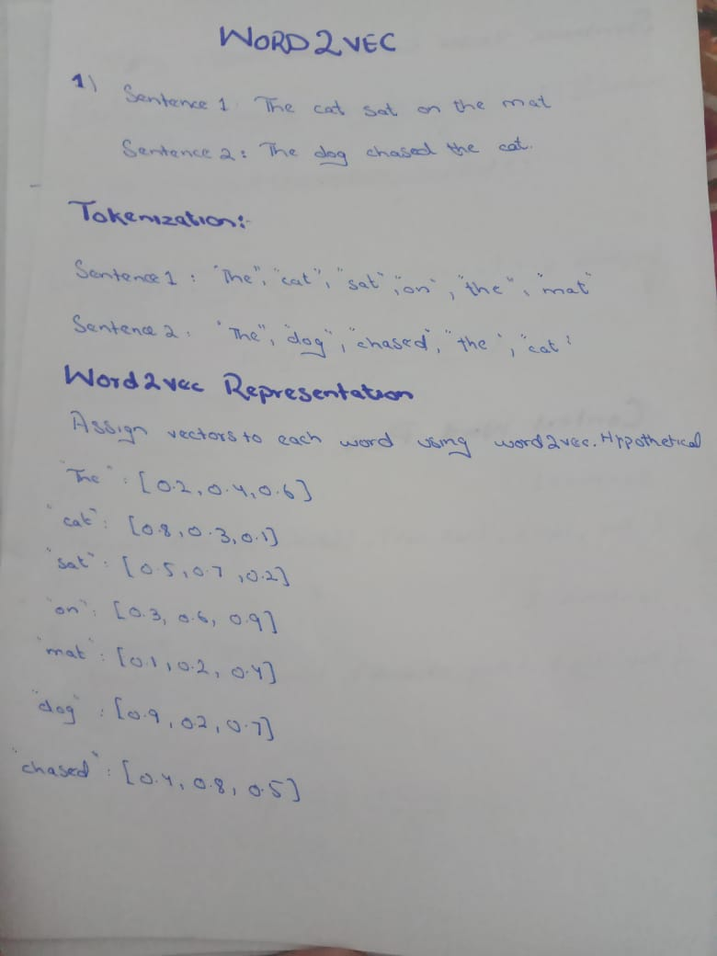
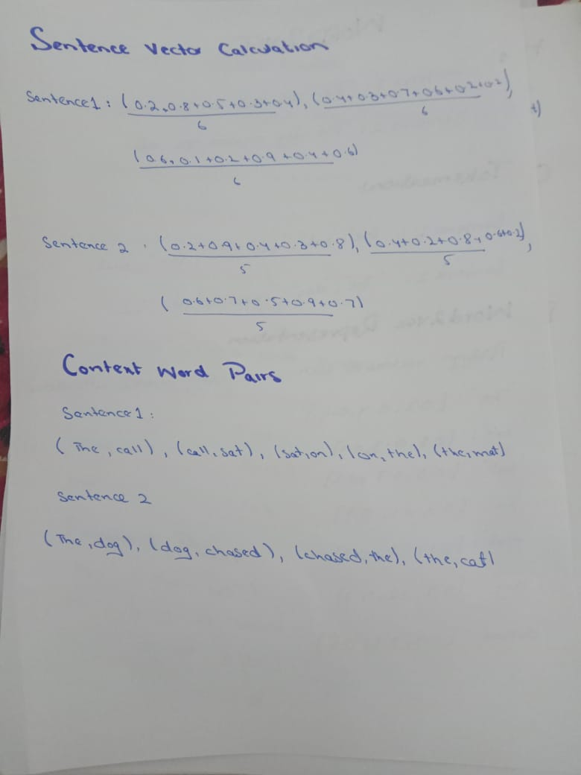

Slide 27
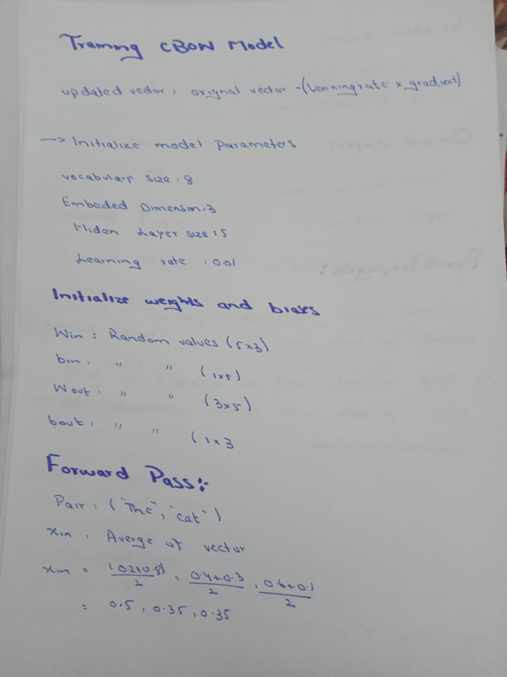
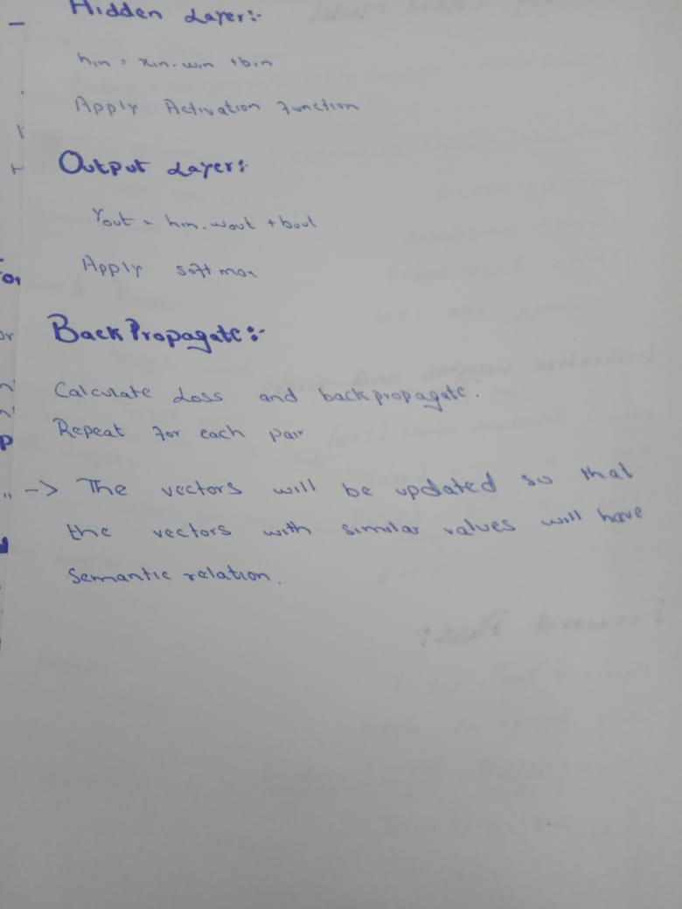

Slide 28
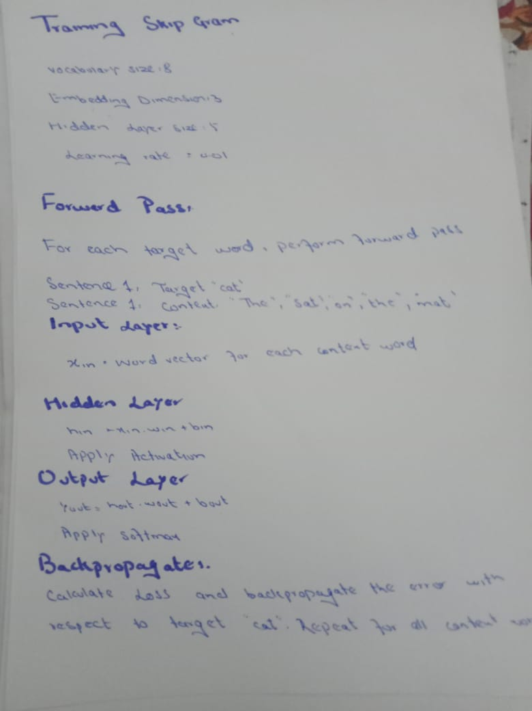

Slide 29
BERT
BERT (Bidirectional Encoder Representations from Transformers) is a state-of-the-art natural language processing (NLP) technique that has revolutionized the way we represent and understand text data.
Unlike traditional word embedding methods like Word2Vec, which treat each word independently, BERT takes into account the context of a word within a sentence, allowing it to capture more complex and nuanced semantic relationships.

Slide 30
BERT Encoding Process
The BERT encoding process involves two main stages:
Pre-training: BERT is pre-trained on a massive dataset of text and code, allowing it to learn general patterns and relationships between words and phrases. This pre-training phase is crucial for developing BERT's ability to understand the context of words in a sentence.
Fine-tuning: Once pre-trained, BERT can be fine-tuned for specific NLP tasks, such as sentiment analysis, question answering, or text summarization. This fine-tuning process involves adjusting the model's parameters to optimize its performance for the specific task at hand.

Slide 31
Example
Consider the sentence: "The cat sat on the mat."
When BERT encounters this sentence, it first breaks it down into individual words: "The", "cat", "sat", "on", "the", "mat". Then, it applies its pre-trained knowledge to understand the context of each word within the sentence. For instance, BERT recognizes that "cat" and "mat" are associated with animals, while "sat" indicates an action.
Using this contextual understanding, BERT generates vector representations for each word in the sentence. These vectors capture not only the individual meaning of each word but also its relationship with the other words in the sentence. The resulting vector representations encode the semantics of the sentence in a way that can be used for various NLP tasks.

Slide 32
Benefits of BERT Encoding
BERT encoding offers several advantages over traditional NLP techniques:
Contextual awareness: BERT's ability to consider the context of a word within a sentence leads to more accurate and nuanced representations of word meanings.
Bidirectional processing: BERT processes text bidirectionally, taking into account both the preceding and following words, which enhances its ability to capture complex semantic relationships.
Generalizability: BERT's pre-training on a massive dataset allows it to be fine-tuned for a wide range of NLP tasks without the need for extensive domain-specific data.

Slide 33
Applications of BERT Encoding
BERT encoding has revolutionized various NLP applications, including:
Sentiment analysis: Classifying the emotional tone of text (positive, negative, neutral)
Question answering: Extracting relevant answers to questions from text passages
Text summarization: Generating concise summaries of lengthy text documents
Natural language generation: Creating coherent and grammatically correct text
Machine translation: Translating text from one language to another

